Slide 1
Machine Learning Project Time Series Data Analysis of OAB Bladder Diaries
By Jiaxiang E and Shaofeng Kang

Slide 2
• Literature Review
Summarize current and emerging methods to collect bladder diary data: Conduct a comprehensive review of existing literature to identify and summarize both traditional and modern methods for collecting bladder diary data, including paper-based and electronic diaries.
• Data Analysis
Apply statistic analysis and graphing techniques to the bladder diary data to obtain an overall understanding of the data and identify distinctive traits within the patient population.
• Data Generation
Expand the limited dataset, generating realistic data based on the existing bladder diary entries to ensure robust training of machine learning models.
• Data Preparation
Preprocessing data and cleaning to be ready for models: Develop implementation for preprocessing and cleaning in-house bladder diary data to ensure it is suitable for machine learning applications.

Slide 3
• Geometric Analysis
Employ geometric analysis to extract features from the time series data generated from the bladder
diaries. Use these features to enhance the predictive models and identify potential characteristics that
can differentiate OAB patients.
• Prediction of Urinary Symptoms
Results of in-house bladder diary data for prediction of the common outcomes investigated: Utilize
machine learning models, including long short-term memory (LSTM) networks, to analyze the preprocessed
bladder diary data and predict changes in urinary symptoms. Assess the predictive performance
of these models using metrics such as accuracy, precision, recall, and F1 score.
• Implementation and Evaluation
Develop a robust machine learning pipeline for the entire process, from data collection and preprocessing
to model training and evaluation. Evaluate the overall performance and effectiveness of the predictive
models and clustering techniques in improving the management of UTS in OAB patients.

Slide 4
Agenda
Re-cap on literature review of current and emerging methods
Re-cap on dataset review and analysis
Model designs and results
Experiments discussion

Slide 5
Re-cap on Literature Rreview

Slide 6
Background: Overactive Bladder (OAB)
Symptoms:
Urgency
Frequency
Nocturia
Urge Incontinence-Leakage of urine
Risks and Causes:
Neurological Disorders
Bladder Obstructions
Pelvic Floor Weakness
Aging
Notes:
Definition: A syndrome characterized by a sudden, involuntary contraction of the muscle in the wall of the urinary bladder leading to urinary urgency.

Slide 7
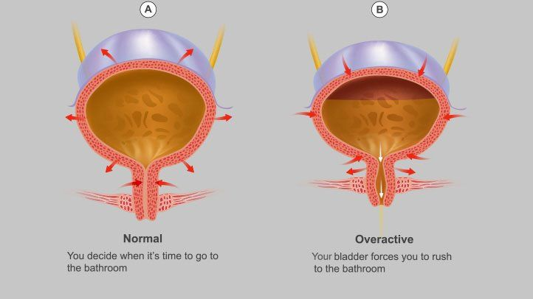
bladder detrusor
Notes:
/di'tru:sə/

Slide 8
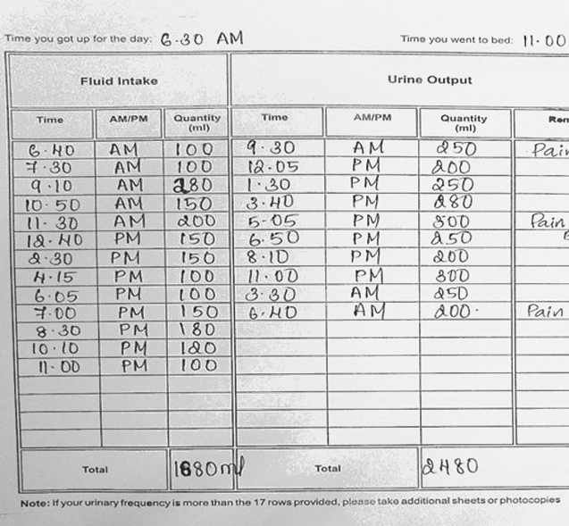
Traditional Methods: Paper-Based Diaries
Description: Patients manually record their urinary habits, including frequency, volume, and incidents of incontinence on paper.
American Urological Association (AUA) Standard
Pros: Simple, no need for electronic devices.
Cons: Prone to inaccuracies, can be cumbersome for patients to carry and maintain, relies on patient's recall and compliance.

Slide 9
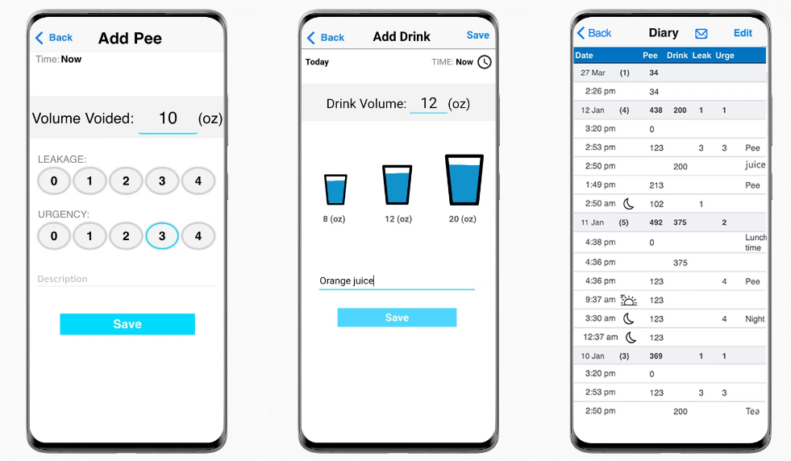
Current Methods: Electronic Diaries (APPs)
Description: Use of electronic devices apps on smartphones, tablets, or computers to log urinary activities.
Pros: Easier data entry, better compliance, include time stamps for accuracy. Reminders and immediate data analysis, no human error.
Cons: Requires access to and familiarity with digital devices, privacy concerns.

Slide 10
Intelligent System With Wearable Device
Urinary management system to collect and analyze urinary time and interval data through smart bands worn by patients.
Recognize urination time and intervals based on patient-specific posture changes.
Utilized recurrent neural networks and long short-term memory (LSTM) systems for analyzing sequential data and recognizing urinary activity.
Average accuracy of 95.8% in recognizing urination events.

Slide 11
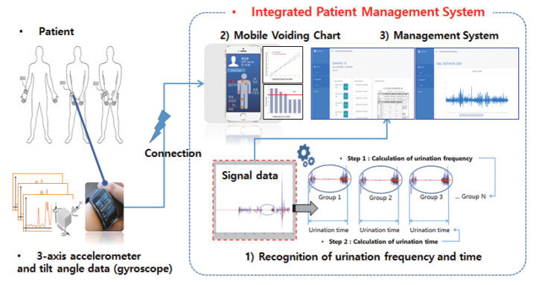
Notes:
Conceptual diagram of the urination management system.

Slide 12
Re-cap on Dataset Analysis

Slide 13
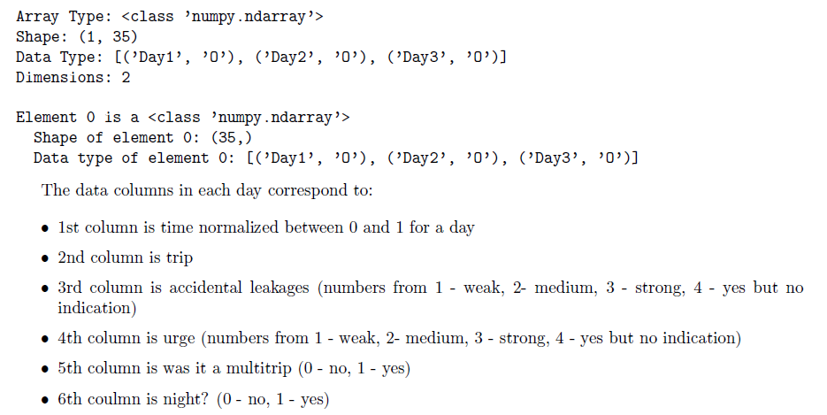
Original Data Formation

Slide 14
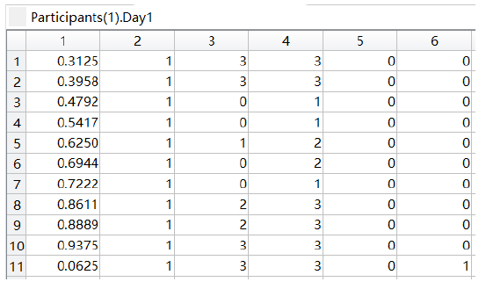
Bladder diary for patient 1, day 1 before treatment

Slide 15
Data Generation Process
Dataset Initialization
The code initializes two datasets: baselines and twelve_weeks, each containing two sets of participant data.
Data Generation Functions
generate_daily_num_of_trips(data): Generates the number of trips for three days based on the frequency distribution of the given data.
generate_one_patient(which_dataset): Generates synthetic data for one patient based on the provided dataset (which_dataset).
– Partial Functions: Creates partial functions to extract columns from the datasets.
– Column Stacking: Initializes empty lists to store column data. These lists are extended with data extracted from the datasets.
– Trip Generation: Generates the number of trips for three days using generate_daily_num_of_trips.
– Time List Generation: Generates sorted lists of times for each day based on the generated number of trips.
– Column Data Generation: Generates synthetic data for other columns (excluding time and night) based on the frequency distributions of the original data.
– Night Determination: Determines whether the generated times fall within the night period.
– Column Stacking: Stacks the generated data columns (including time and night) for each day.

Slide 16
Execution Flow
• Data Initialization: The baseline and 12-week datasets are initialized.
• Data Generation: The generate_one_patient function is called to generate synthetic data for one patient.
Data Generation
• Column Extraction: Relevant columns (time, trips, urges, etc.) are extracted from the original datasets.
• Frequency-Based Sampling: New data samples are generated based on the frequency distributions of the extracted columns.
• Data Stacking: The generated data is organized into structured arrays, representing the synthetic patient’s daily activities.

Slide 17
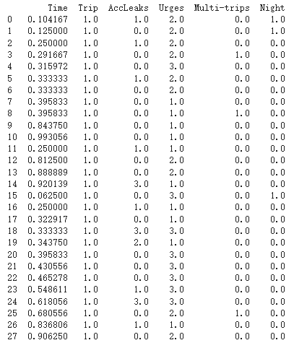
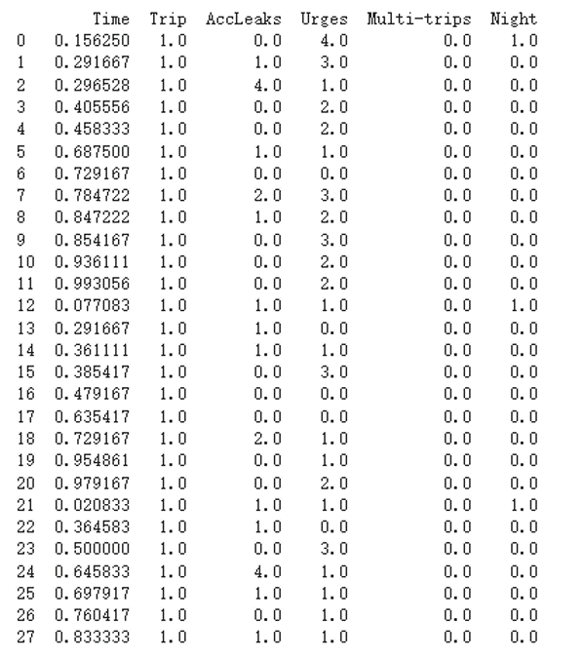
Generated Data Patient No.1 (3 Days)
Baseline Week 12

Slide 18
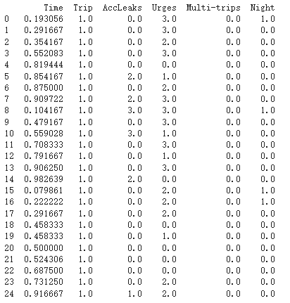
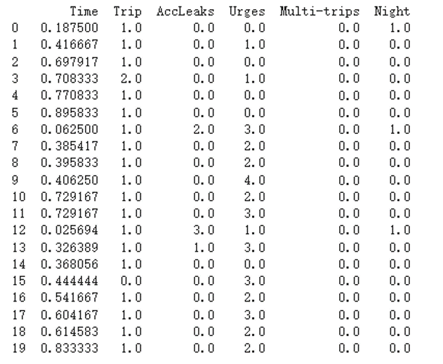
Generated Data Patient No.999 (3 Days)
Baseline Week 12

Slide 19
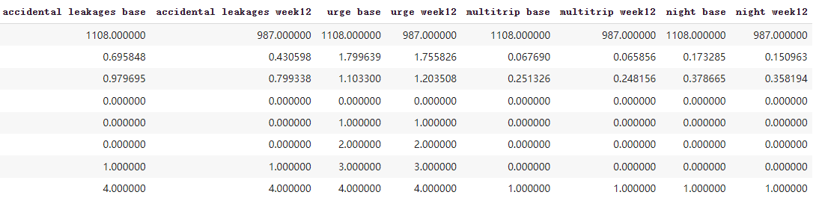
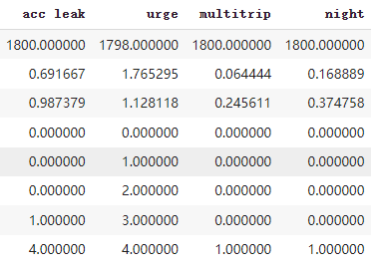
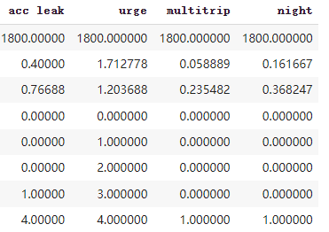
Statistical Comparison Between Original and Generated Data
Original:
Generated: Baseline Week 12

Slide 20
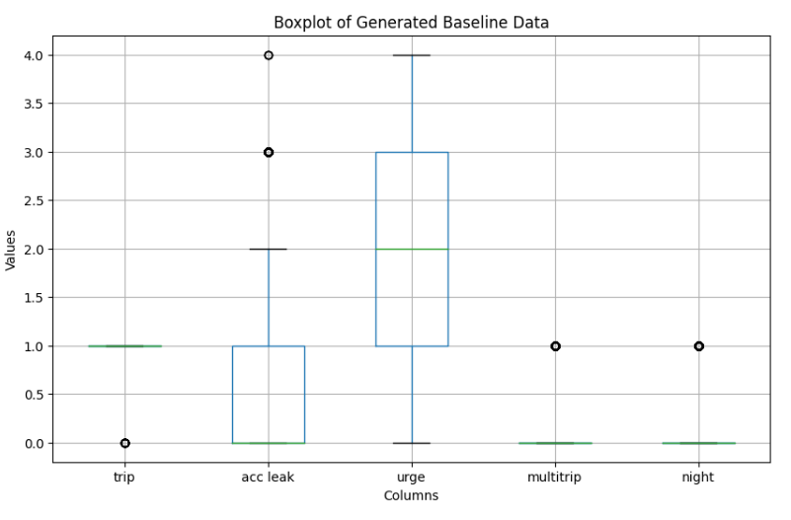

Slide 21
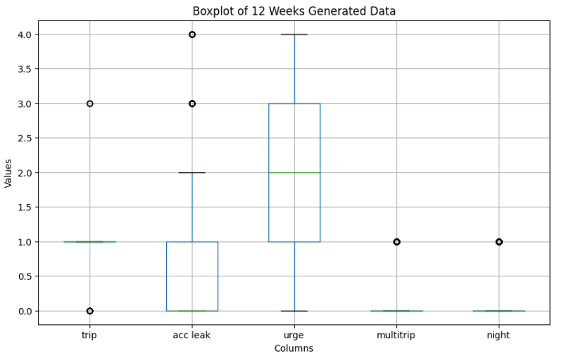

Slide 22
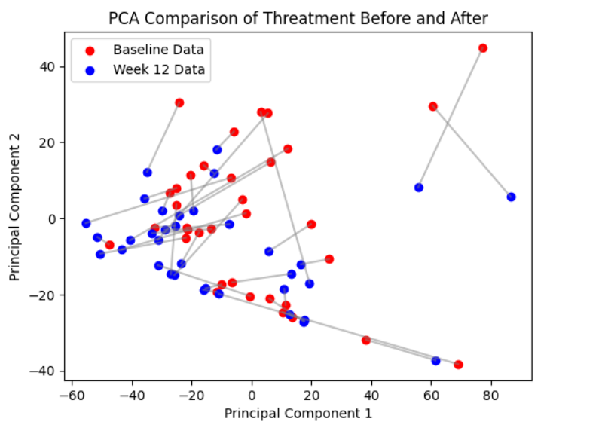
PCA Comparison for Baseline and Week12
Notes:
PCA is a statistical technique that reduces multiple variables of the data to a few principal components that capture the maximum variance in the data. Doing so helps us reduce dimensionality while retaining the most important data features. The two axes in the graph, "Principal Component 1" and "Principal Component 2", represent the two directions where the data changes the most.
Data clustering: Baseline data and week 12 data appear to form two different clusters in principal component space.
Time or treatment effect: Since the chart title mentions a comparison between baseline and week 12, we can infer that these points may represent observations over time in a certain condition or the effect of a certain treatment.
Direction of change: It appears that the data for week 12 have some degree of shift in the direction of the first principal component, indicating that the main direction of change in the data has changed over time or the application of processing.

Slide 23

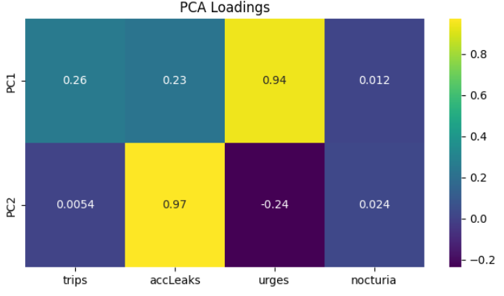

Slide 24
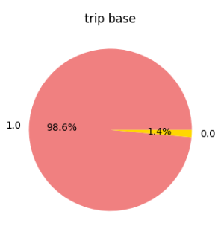
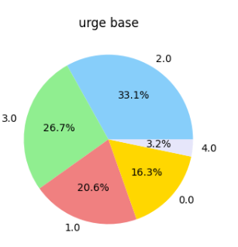
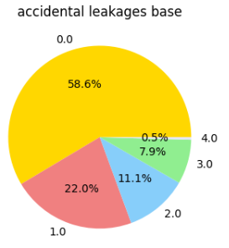
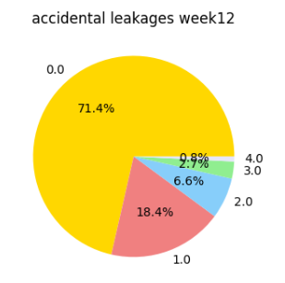
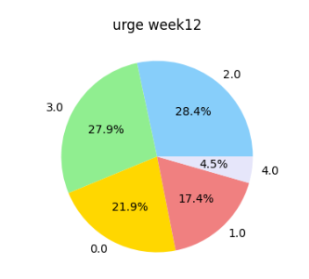
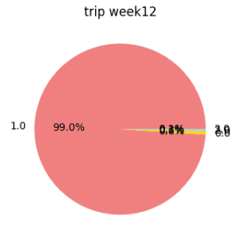
Pie Charts Comparisons: Baseline vs. Week 12

Slide 25
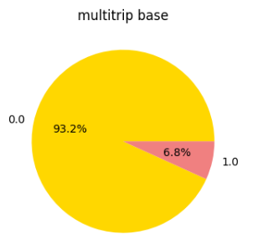
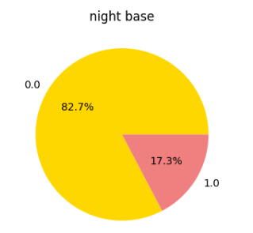
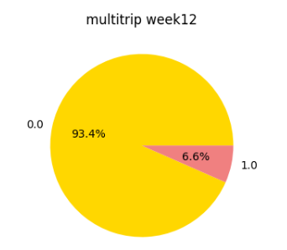
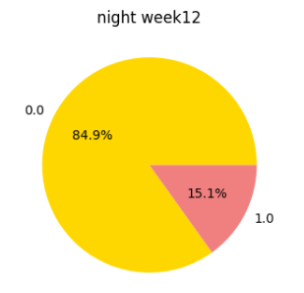

Slide 26
Score Statistical Data
accLeaks sum of differences: -352
accLeaks percentage change max & min & average: 200.0, -100.0, -20.24
accLeaks t-statistic & p_value: 4.38, 0.00011
accLeaks cohens_d: 0.60
urges sum of differences: -277
urges percentage change max & min & average: 49.06, -100.0, -16.67
urges t-statistic & p_value: 2.09, 0.044
urges cohens_d: 0.27
Notes:
t-statistic
The full name is t value or t statistic. The t-statistic is a standardized value of the difference between the sample mean and the hypothesized population mean. The t-statistic allows us to assess whether the difference between the sample mean and the population mean arises by chance or is large enough to be considered substantively different. Large t-statistic values generally indicate that the observed differences are unlikely to be caused solely by random fluctuations.
p-value
The p-value is a probability value used in hypothesis testing. It measures the probability that an observed statistic (such as the t-statistic) is at least as extreme as the actual observation, given that the null hypothesis is true. . If the p-value is small, such as less than a commonly used significance level (such as 0.05), it indicates that the inconsistency between the observed data and the null hypothesis is large enough to reject the null hypothesis. In other words, a small p-value indicates that we have enough evidence to think that the data are inconsistent with the null hypothesis.
Cohen's d
Cohen's d is an effect measure that expresses the size of the difference between two population means relative to their standard deviations. The larger the Cohen's d value, the more significant the difference between the two groups. It is a standardized measure that allows us to compare the size of effects across different studies. Cohen's d can be interpreted as small effect (d = 0.2), medium effect (d = 0.5), and large effect (d = 0.8).

Slide 27
Score Statistical Data
trips sum of differences: -106.0
trips percentage change max & min & average: 23.33, -42.31, -9.21
trips t-statistic & p_value: 3.42, 0.0016
trips cohens_d: 0.29
nocturia sum of differences: -43.0
nocturia percentage change max & min & average: 400.0, -100.0, -13.78
nocturia t-statistic & p_value: 2.62, 0.013
nocturia cohens_d: 0.34

Slide 28
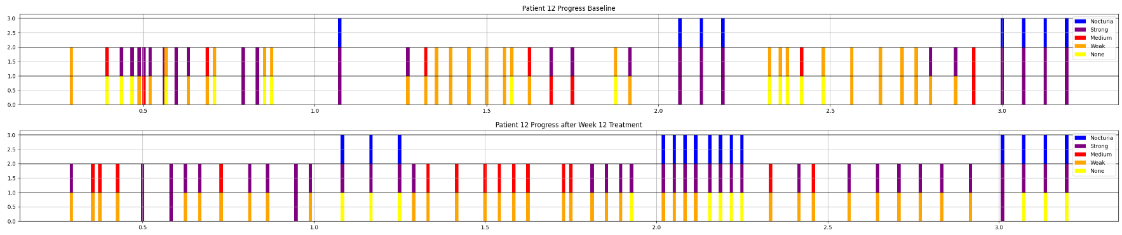
Time Series Data for Patient 12 Baseline and 12 Weeks
On y-axis: 0~1 is accLeaks, 1~2 is urges, 2~3 is Nocturia

Slide 29
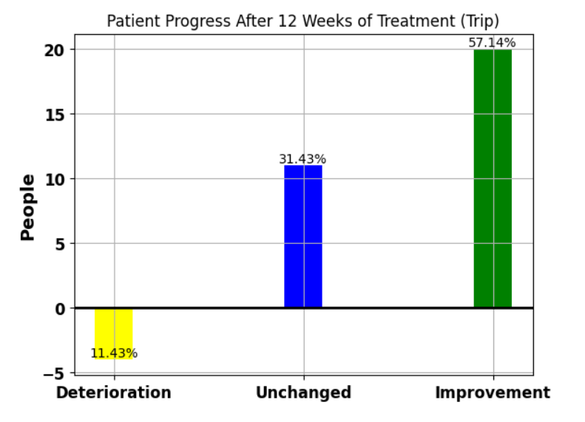

Slide 30
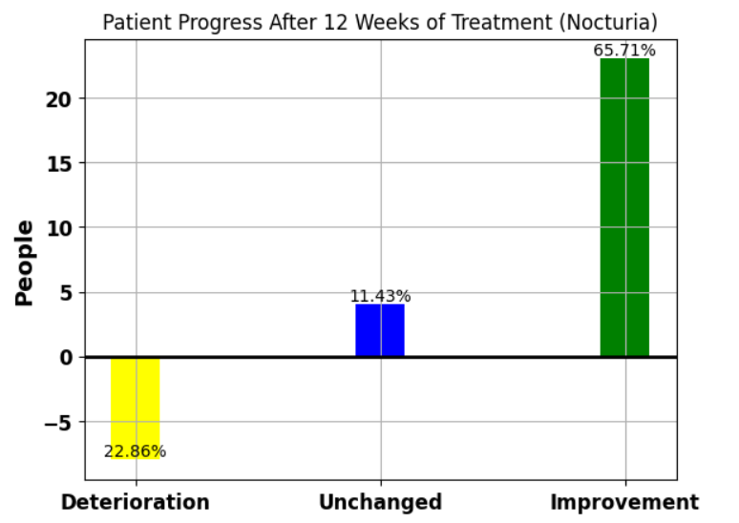

Slide 31
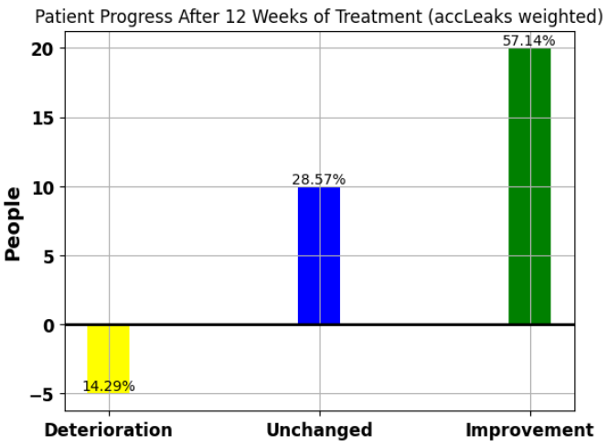
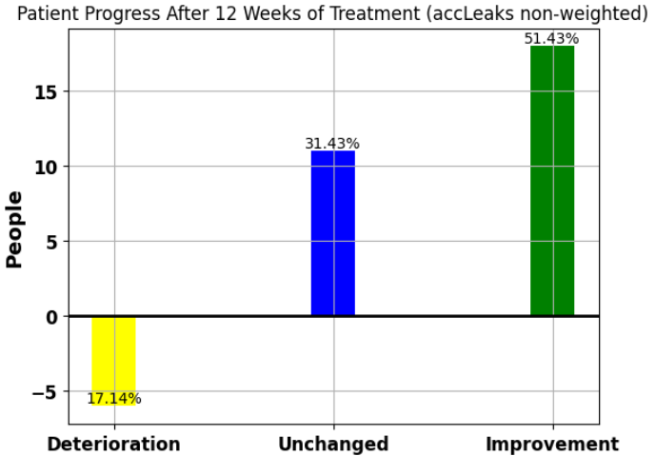

Slide 32
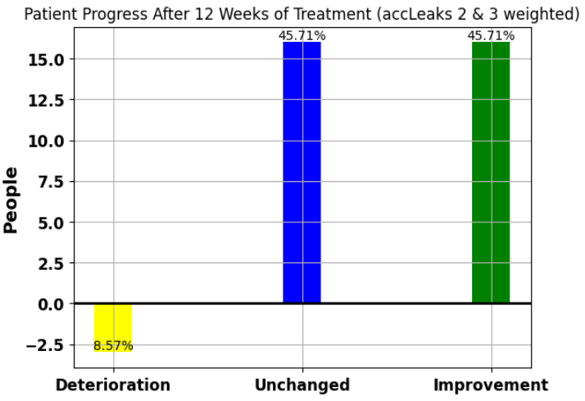

Slide 33
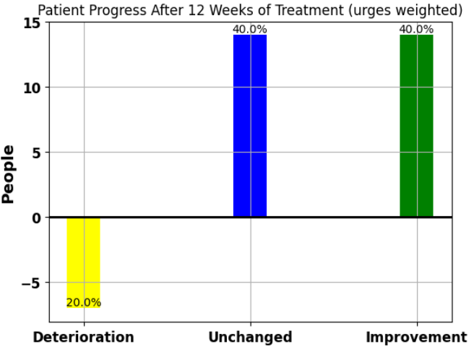
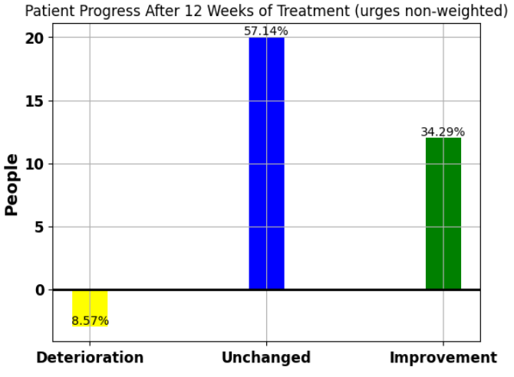

Slide 34
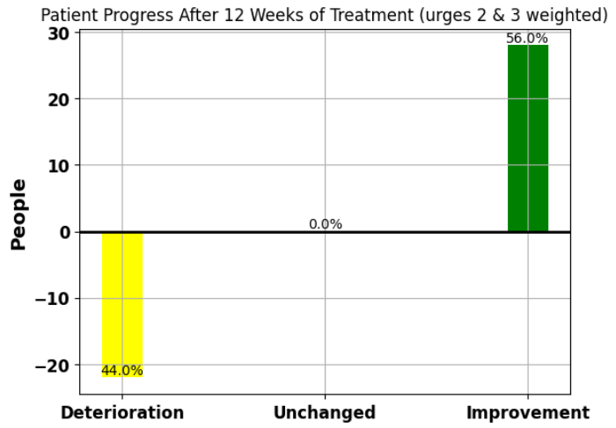

Slide 35
Data Labeling Rules
The purpose of this labeling rule is to classify patients into three categories based on the effectiveness of
a treatment. There are solely two label for each patient, 0 and 1. The classification labels are defined as follows:
• 0 (No Significant Effect): The treatment has little to no significant effect on the patient.
• 1 (Significant Improvement): The treatment has a significant positive effect on the patient.

Slide 36
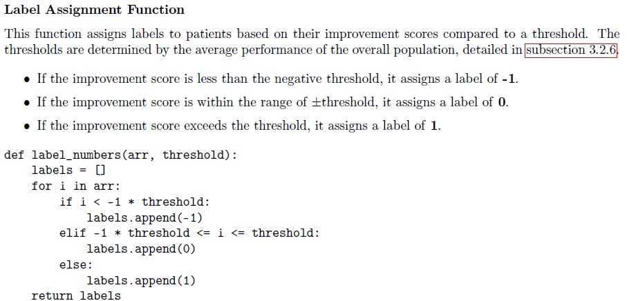
Notes:
Label Assignment: The function label_numbers evaluates individual improvement scores on each
category against a threshold to classify them into -1, 0, or 1. This helps in distinguishing between
significant deterioration, no significant change, and significant improvement.

Slide 37
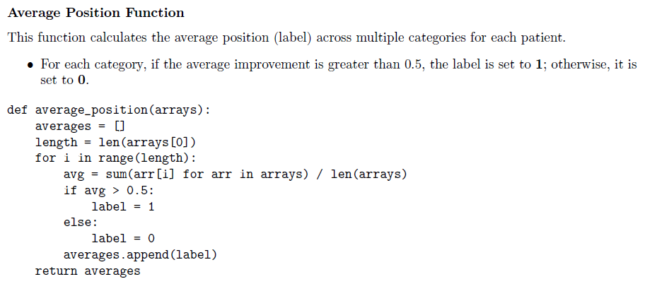
Notes:
• Average Position: The function average_position aggregates the labels across multiple categories
and assigns a final label based on the average improvement. This ensures that the final label reflects
an overall assessment rather than a category-specific one.

Slide 38
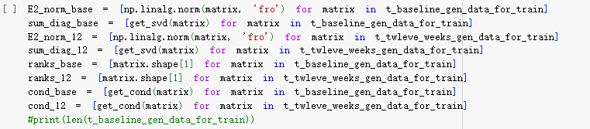
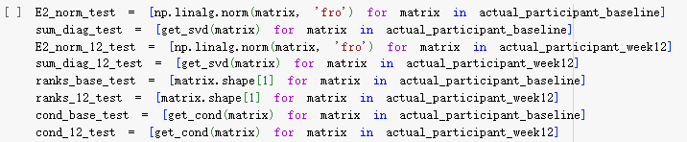
Linear Algebra Analysis

Slide 39

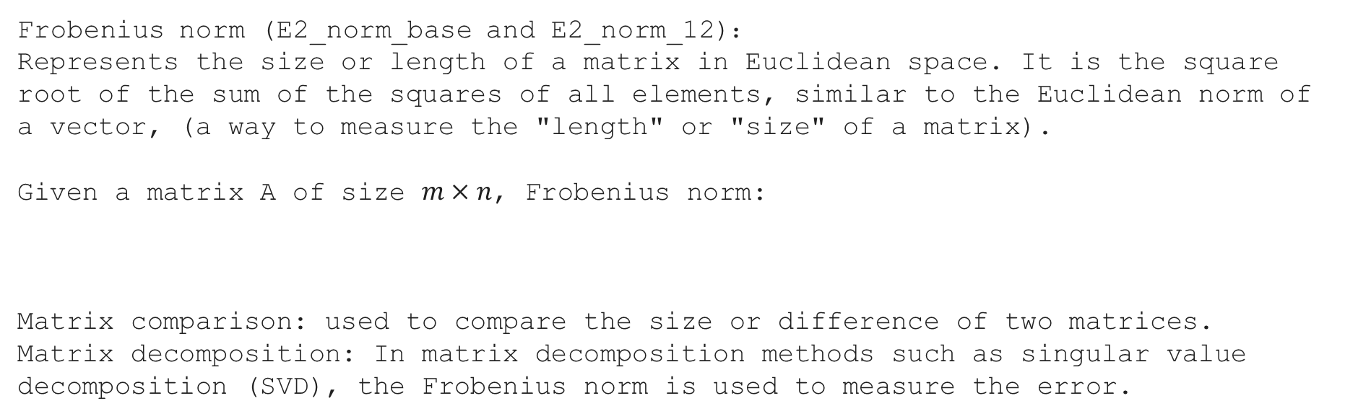
Linear Algebra Analysis
Frobenius norm (E2_norm_base and E2_norm_12)：
Represents the size or length of a matrix in Euclidean space. It is the square root of the sum of the squares of all elements, similar to the Euclidean norm of a vector, (a way to measure the "length" or "size" of a matrix).
Given a matrix A of size $m×n$, Frobenius norm:
Matrix comparison: used to compare the size or difference of two matrices.
Matrix decomposition: In matrix decomposition methods such as singular value decomposition (SVD), the Frobenius norm is used to measure the error.

Slide 40
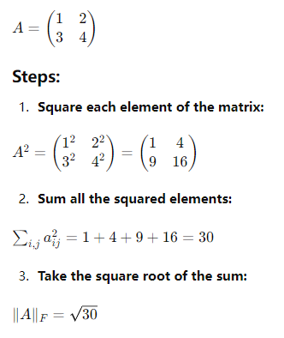
Frobenius Norm (Euclidean Norm) Example

Slide 41

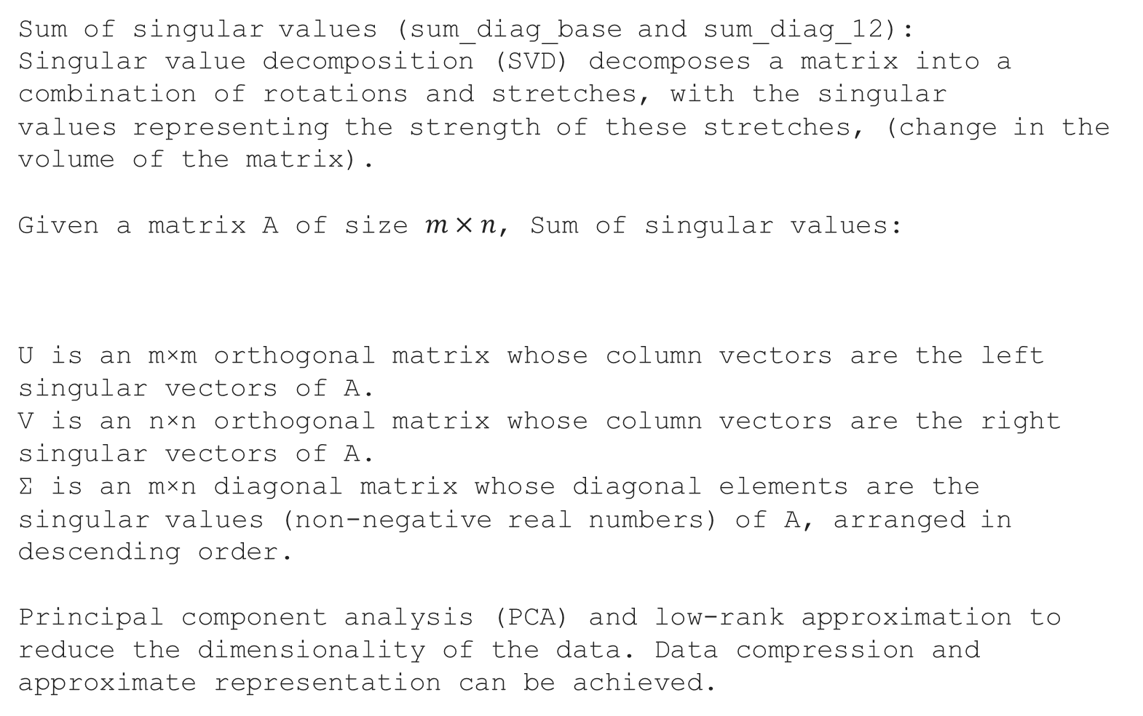
Sum of singular values ​​(sum_diag_base and sum_diag_12):
Singular value decomposition (SVD) decomposes a matrix into a combination of rotations and stretches, with the singular values ​​representing the strength of these stretches, (change in the volume of the matrix).
Given a matrix A of size $m×n$, Sum of singular values:
U is an m×m orthogonal matrix whose column vectors are the left singular vectors of A.
V is an n×n orthogonal matrix whose column vectors are the right singular vectors of A.
Σ is an m×n diagonal matrix whose diagonal elements are the singular values ​​(non-negative real numbers) of A, arranged in descending order.
Principal component analysis (PCA) and low-rank approximation to reduce the dimensionality of the data. Data compression and approximate representation can be achieved.

Slide 42
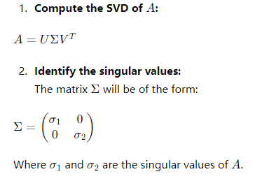

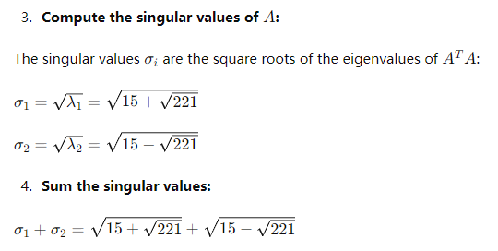
Sum of Singular Value Example

Slide 43

Number of columns of a matrix (ranks_base and ranks_12):
Geometrically, the number of columns of a matrix (if the matrix is ​​full rank) represents the number of dimensions that the matrix can describe.
Condition number (cond_base and cond_12):
The condition number measures the stability of a matrix in numerical computations. A high condition number indicates that the matrix is ​​close to being singular (irreversible) and may lead to amplified errors in numerical computations, (a measure of the maximum and minimum stretch ratios in matrix transformations).
The condition number is usually denoted by κ(A). For a matrix A, its condition number is defined as:
Where ||A|| is the L2 norm of the matrix A.

Slide 44
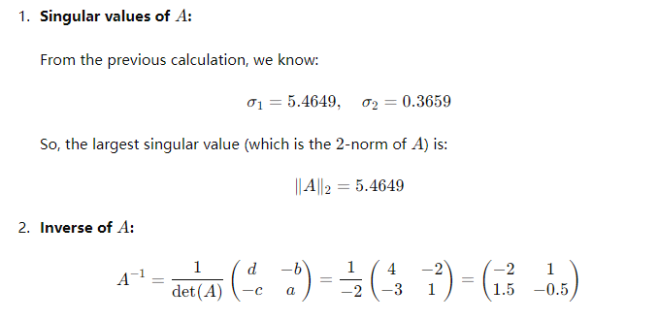
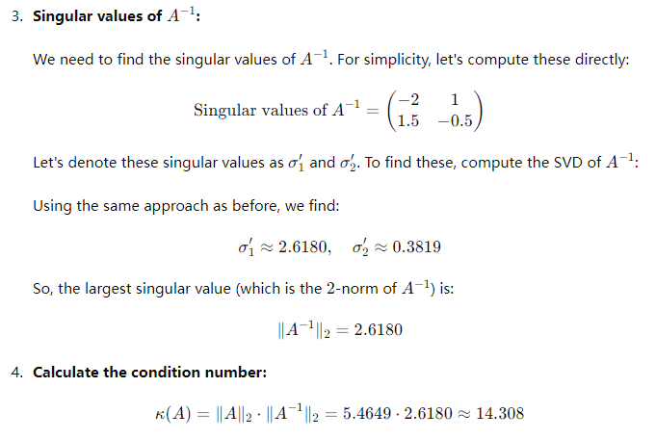
Condition Number Example

Slide 45
Models Training and Results

Slide 46
Data Splitting
For experiments on the original bladder diary database, the dataset is divided into training and testing subsets. No validation set is included since it is very limited. The training set has 28 patients, and the testing set has 7 patients. A random shuffle setting is activated so that in each epoch the training set and test set patient switches.
For experiments on generated data, there are 10,000 samples been generated and the data formation is split as follows:
Training set: 80%, so 8,000 samples
Validation set: 20%, so 2,000 samples
Testing set: 35 real bladder diary dataset
This split helps in assessing the model's performance during training and ensures that the final evaluation on the test set provides an unbiased estimate of the model's accuracy.

Slide 47
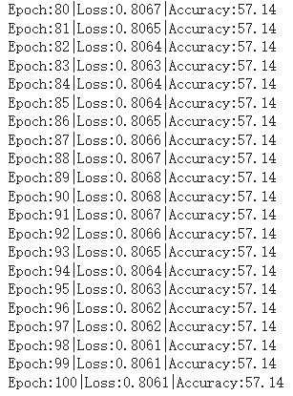
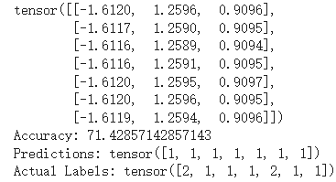
Vanilla RNN with Raw Time Series Data

Slide 48
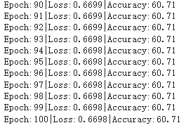

Basic RNN with Raw Time Series Data (Generated)

Slide 49


LSTM RNN with Raw Time Series Data

Slide 50


LSTM RNN with Raw Time Series Data(Generated)

Slide 51
Rank of the Top Catch 22 Features (Start with the most Correlated)
('1-11', 0.44431688040260514): IN_AutoMutualInfoStats_40_gaussian_fmmi
('2-12', 0.3650549858377052): FC_LocalSimple_mean1_tauresrat
('0-17', 0.3166510047167144): SB_MotifThree_quantile_hh
('0-21', 0.3161531238848879): FC_LocalSimple_mean3_stderr
('2-21', 0.3074345634831996): FC_LocalSimple_mean3_stderr
('0-0', -0.29233007785198895): DN_HistogramMode_5
('0-16', 0.29035716696288083): SB_BinaryStats_diff_longstretch0
('2-15', -0.2806159768212398): SP_Summaries_welch_rect_area_5_1
('2-5', 0.27763869801950414): CO_trev_1_num
('0-6', 0.27754353514553365): MD_hrv_classic_pnn40
('2-0', 0.27721011211819224): DN_HistogramMode_5
('1-18', -0.2771806392200773): SC_FluctAnal_2_rsrangefit_50_1_logi_prop_r1
0: AccLeakage 1: Urges 2:Nocturia

Slide 52

FNN With All Catch 22 Features

Slide 53

FNN With Top 5 Catch 22 Features: Performance Over 100 Runs

Slide 54



LassoLars (a variant of Lasso regression) to fit the data

Slide 55

Gradient Boosting to fit the data

Slide 56
Support Vector Machine (SVC) to fit the data

Slide 57

Sequential LSTM Model Summary

Slide 58


Performance Over 50 Runs

Slide 59


Slide 60
Experiments Discussion

Slide 61
Comparison with Vanilla RNN:
Training on a small dataset of 35 patients yielded a train accuracy of 57.14% and a test accuracy of 71.43%, indicating some learning but limited by sample size.
Using a larger generated dataset of 10,000 samples, the Vanilla RNN achieved a slightly improved accuracy of 60.71% with a lower loss, showing similar performance due to statistical resemblance between datasets.
The model was too simplistic, and raw time series data was insufficient for accurately predicting treatment outcomes.
Comparison with LSTM RNN:
On the original dataset, LSTM RNN showed significant fluctuation and overfitting, with a final test accuracy of 42.86%
Training on the generated dataset improved stability and generalization, achieving a test accuracy of 52.88% and lower loss.
LSTM outperformed Vanilla RNN on the generated dataset, indicating its sensitivity to data volume and complexity.
Original Dataset with GRU RNN:
GRU RNN showed stable accuracy similar to Vanilla RNN and LSTM, with a final test accuracy of 71.43%.
It faced challenges in capturing complex patterns with a small dataset.

Slide 62
Experiments on Catch22 Features (Original Dataset):
Using all 22 Catch22 features, the Feedforward Neural Network (FNN) achieved high training accuracy but low validation accuracy (42.86%), indicating overfitting.
Training with only the top 5 correlated features reduced overfitting, achieving a validation accuracy of 57.14% with improved generalization.
Experiments on Geometric Features (Generated Dataset):
The one-layer Sequential LSTM model showed stable training performance but poor generalization on the test set, with test accuracy of 44.83% and F1 score of 0.2000.
A more complex multi-layer Sequential LSTM model with dropout layers improved performance significantly, achieving a test accuracy of 81.82% and F1 score of 0.7778.
The multi-layer model's confusion matrix showed improved precision and recall, indicating better class prediction and reduced bias.
The study concludes that a multi-layer LSTM model trained on a larger, comprehensive dataset captures complex patterns effectively, leading to higher accuracy and robustness.

Slide 63
Number of non-responders (30% threshold): 7414 (76.75%) Number of responders (30% threshold): 2246 (23.25%)
Number of non-responders (50% threshold): 9271 (95.97%)
Number of responders (50% threshold): 389 (4.03%)
Number of non-responders (average threshold): 4878 (50.50%) Number of responders (average threshold): 4782 (49.50%)

Slide 64
Future Exploration
How do we further improve the way we define someone is a responder or not (analysis method)?
Gen data quantity vs gen data accuracy
Responder vs non responder # per day certain pattern and behavior
Given baseline and week12, predict with only baseline, or pure baseline or 9 features including Catch 22 and geometric analysis
Does a pattern exist in baseline will cause the responder to occur?

Slide 65
References
[1] Cameron AP, Wiseman JB, Smith AR, Merion RM, Gillespie BW, Bradley CS, Amundsen CL, Yang CC, Lai HH, DeLancey JOL, Helmuth ME, Bradley MS, Agochukwu N, Andreev VP, Kirkali Z, Clemens JQ; LURN Study Group. Are three-day voiding diaries feasible and reliable? Results from the Symptoms of Lower Urinary Tract Dysfunction Research Network (LURN) cohort. Neurourol Urodyn. 2019 Nov;38(8):2185-2193. doi: 10.1002/nau.24113. Epub 2019 Jul 25. PMID: 31347211; PMCID: PMC6801005.
[2] Shrivastava N, Sarangi SS, Tripathi S, Bhargava P, Bhirud DP, Jena R. Bladder diary for illiterates: A novel method. Urologia Journal. 2023;90(4):748-756. doi:10.1177/03915603231187684
[3] Park, Seung-Min et al. “A mountable toilet system for personalized health monitoring via the analysis of excreta.” Nature biomedical engineering vol. 4,6 (2020): 624-635. doi:10.1038/s41551-020-0534-9

Slide 66
[4] Hafid, Abdelakram et al. “State of the Art of Non-Invasive Technologies for Bladder Monitoring: A Scoping Review.” Sensors (Basel, Switzerland) vol. 23,5 2758. 2 Mar. 2023, doi:10.3390/s23052758
[5] Jo, Hyeong Geun et al. “Forward-Looking Ultrasound Wearable Scanner System for Estimation of Urinary Bladder Volume.” Sensors (Basel, Switzerland) vol. 21,16 5445. 12 Aug. 2021, doi:10.3390/s21165445
[6] Hsiao, SM., Lin, HH. Feasibility and clinical implications of 3-day bladder diary derived classification of female storage lower urinary tract symptoms. Sci Rep 12, 20339 (2022). https://doi.org/10.1038/s41598-022-24539-1
[7] Niederhauser T, Gafner ES, Cantieni T, Grämiger M, Haeberlin A, Obrist D, Burkhard F, Clavica F. Detection and quantification of overactive bladder activity in patients: Can we make it better and automatic? Neurourol Urodyn. 2018 Feb;37(2):823-831. doi: 10.1002/nau.23357. Epub 2017 Jul 26. PMID: 28745806.

Slide 67
[8] Abelson, Benjamin et al. “Ambulatory urodynamic monitoring: state of the art and future directions.” Nature reviews. Urology vol. 16,5 (2019): 291-301. doi:10.1038/s41585-019-0175-5
[9] Yande, Shirish Dattatraya et al. “Role of urodynamics in stress urinary incontinence: A critical appraisal.” Journal of mid-life health vol. 7,3 (2016): 119-125. doi:10.4103/0976-7800.191016
[10] Jiang, Yuan-Hong et al. “Role of videourodynamic study in precision diagnosis and treatment for lower urinary tract dysfunction.” Ci ji yi xue za zhi = Tzu-chi medical journal vol. 32,2 121-130. 18 Nov. 2019, doi:10.4103/tcmj.tcmj_178_19
[11] Bogusiewicz, Michał. “Ultrasound imaging in urogynecology - state of the art 2016.” Przeglad menopauzalny = Menopause review vol. 15,3 (2016): 123-132. doi:10.5114/pm.2016.63060

Slide 68
[12] Cartwright, R., Afshan, I., Derpapas, A. et al. Novel biomarkers for overactive bladder. Nat Rev Urol 8, 139–145 (2011). https://doi.org/10.1038/nrurol.2011.7
[13] Werneburg, Glenn T. “Catheter-Associated Urinary Tract Infections: Current Challenges and Future Prospects.” Research and reports in urology vol. 14 109-133. 4 Apr. 2022, doi:10.2147/RRU.S273663
[14] Eun, Sung-Jong et al. “Personalized Urination Activity Management Based on an Intelligent System Using a Wearable Device.” International neurourology journal vol. 25,3 (2021): 229-235. doi:10.5213/inj.2142276.138

Slide 69
[15] Gadalla, Amal A H et al. “Identification of clinical and urine biomarkers for uncomplicated urinary tract infection using machine learning algorithms.” Scientific reports vol. 9,1 19694. 23 Dec. 2019, doi:10.1038/s41598-019-55523-x
[16] Lubba, C.H., Sethi, S.S., Knaute, P. et al. catch22: CAnonical Time-series CHaracteristics. Data Min Knowl Disc 33, 1821–1852 (2019). https://doi.org/10.1007/s10618-019-00647-x

